Slide 1










Our School Offer and
Information Report
2025 - 2026
1) SENCO
3) What types
of SEND do
we provide
for?
2) Identifying children with SEND
5) Arrangements
for
education
4) Parent
involvement
14) Working with
other support
agencies
6) How we
assess and review progress
13)SEND
training
for staff
7) Support
for transitions between key-stage phases and schools
10) Additional support for children with
SEN
8)Approach to teaching
children with SEND
12) Adapting the
Curriculum to
support children’s
additional needs
9) How are children
are included in all the
school has to offer?
Part 1

Slide 2




Who is the SENCO?
Hello, my name is Mrs McGill, and I am the Assistant Headteacher for SEND and Inclusion at Grace Cook Primary School and Nursery. I am passionate about ensuring that every child, regardless of their starting point or individual needs, has access to high-quality education and the right support to thrive both academically and personally. My role focuses on leading our provision for pupils with special educational needs and disabilities (SEND), as well as championing inclusive practices across the whole school. I work closely with staff, families, and external agencies to ensure we create a nurturing, inclusive environment where all children feel valued, understood, and empowered to reach their full potential.
My working days are ordinarily Monday- Wednesday and you can contact me at senco@gracecook.omat.org.uk.

Slide 3


How will children with Special Educational Needs be identified and what sorts of assessments will be completed?
Baseline tests – reading ages / spelling ages
Teacher / TA / SENCO identification through observation / marking / book sampling
Admission meetings
Parent information concerns
Tracking progress through interventions
Insight Tracking analysis
Phonics screening
Speech and language screening
Early Years baseline
Literacy assessments
Maths assessments
Pre-school assessments and liaisons between settings
Therapist assessments e.g. speech and language, occupational therapy
If children come into school with an Education Health and Care Plan or medical diagnosis already in place

Slide 4





What kind of SEND does the school provide for?
A pupil has SEND where their learning difficulty or disability calls for special educational provision, that is provision different from or additional to that normally available to pupils of the same age.
Special educational needs and provision can be considered as falling under four broad areas:
o Communication and interaction
o Cognition and learning
o Social, mental and emotional health
o Sensory and / or physical

Slide 5







How do we talk to you and involve you in your child’s education?
Formal – these may include: | Informal – these may include:
Parent consultation meetings Termly review meetings Your views Inviting you in to meet with professionals Annual Reviews for children with an Educational Health and Care Plan | Informal discussion with staff Arbor messaging Phone calls SEND Newsletter Parent workshops

Slide 6


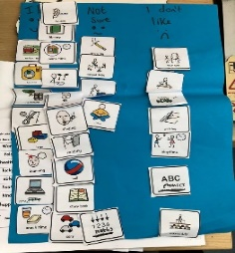

What arrangements are there for involving your child in their education?
Formal – These may include: | Informal – These may include:
My views section of Support Plan Input into EHCP Pupil voice | Conversation with staff Progress reviews School Council Discussion with professionals working with the child

Slide 7




What arrangements are there for assessing and reviewing children’s progress?
These may include:
Progress reviews
Range of assessments in school and by outside agencies
Pupil views
Parent views
School tracking systems
Observations

Slide 8

What arrangements are there for supporting children and young people in moving between schools?
Pre-school /nursery to Reception | Foundation to Key Stage 1 | Key Stage 1 – Key Stage 2 | Key Stage 2 – Key Stage 3 | Moving between schools
Home visits Nursery/Child-minder visits Welcome meetings and booklet Tea and chat School tours Transition visits Transition programme Photo books Liaison with preschool staff Move round days | Transition programme Welcome meetings to set out expectations (Meet the Teacher) Teacher hand over meeting Liaison with SENCO | Transition programme Welcome meetings to set out expectations (Meet the Teacher) Teacher hand over meeting Liaison with SENCO | Teacher hand over meeting Transition programme Welcome meetings to set out expectations (Meet the Teacher) Liaison with SENCO Extra visits to secondary schools Parents encouraged to visit a range of secondary schools to ascertain appropriate secondary provision for their child Staff supported visits if needed Support for parents when visiting secondary schools if needed Open Days and Taster Days Year 6 annual reviews Transition Books if needed Additional transition meetings as necessary | Liaison between SENCOs Paperwork to be forwarded as soon as possible If children are from out of county, EHCP to be re-written into the Suffolk Format Admissions meeting with pastoral members, you the parents and your child Visit to school

Slide 9



What is the approach to teaching children and young people with SEND?
Teachers are responsible and accountable for the progress and development of the pupils in their class, including where pupils access support from teaching assistants or specialist staff’
[Code of Practice; June 2014: 6.36]
Graduated approach linked to assess, plan, do, review
Quality First Teaching / SEN Support / Education, Health and Care Plan
Provision which is ‘additional to and different from’
Taking account of recommendations from specialist outside agencies
Relevant research-based intervention programmes linked with provision guidance

Slide 10

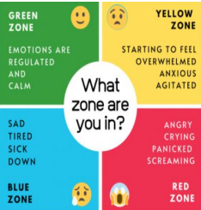
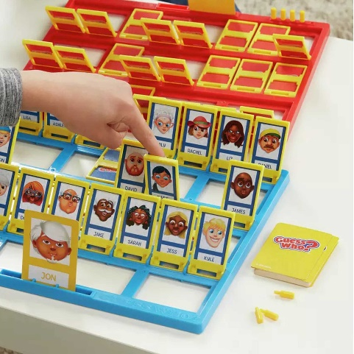







What additional support does Grace Cook offer children with SEND?
Play Therapy | Literacy Gold intervention | Sensory Room | Zones of Regulation | Nurture Breakfast Clubs
KS2 Phonic Interventions | Speech and language specialist teaching assistant | Speech & Language Therapist | Block therapy | Hamish and Milo SEMH small group

Slide 11

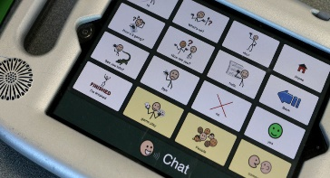
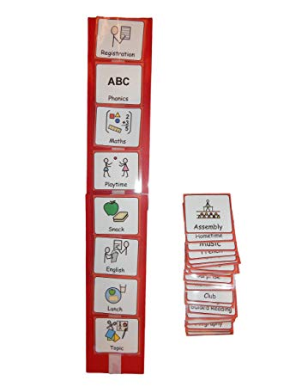



How are adaptations made to the curriculum and the learning environment?
Changes and adaptations to the physical
environment
Use of assistive technology
Visual timetables
Advice taken from professionals
Specialist resources
Playtime provision
Parental and pupil suggestions

Slide 12




What expertise and training do staff supporting SEN have?
All school staff receive regular training relating to SEND We have staff specifically trained in: ELSA Makaton Diploma in Trauma and mental health Lego therapy Elklan Drawing and talking Zones of regulation Hamish and Milo | In addition staff may have access to the following: Specialist Teacher advice Educational Psychologist advice Speech and Language Therapist advice Occupational Therapist advice Physiotherapist advice Advice from Emotional and Well-being Mental Health Service Play Therapist support Outreach support Support workers SENCO update meetings and specific training School Nurse

Slide 13




How does the school involve other professionals and support services?
Invite to EHCP/Annual Review meetings Invite to Team Around the Child / Team Around the Family meetings Open door policy | Referrals as appropriate to: Paediatrician Emotional Wellbeing Hub Mental Health Support Team Speech And Language Therapist [SALT] Early Help Educational Psychologist [EP] Specialist Teachers [SES] Occupational Therapist [OT] Play Therapist | Family Support to include signposting to: SENDIASS Suffolk Local Offer Early Help Suffolk NDD Pathway Suffolk Family Carers Autism Anglia Bellscroft Behaviour Safe at home

Slide 14


How are children included in all that our school has to offer?
Quality First Teaching
Adapted teaching and adjustments
Inclusion in activities / curriculum
Adapted resources
Bespoke equipment as advised by professionals
Access to before and after school clubs
Nurture breakfast club
Hamish and Milo nurture groups
Zones of Regulation whole class and small group support
Lego therapy
Drawing and talking
Adult or peer support, as necessary, to help children access all areas of the curriculum
Bespoke curriculum under the advice of professionals
Enrichment activities
Access to evidence-based interventions

